Slide 1

Introduction to Data Analytics
A General-Purpose Teaching Presentation
Scope of the Presentation: Covers foundational concepts, applications, lifecycle, and statistical tools used in data analytics.
Target Audience: Designed for educators and learners across disciplines to grasp analytics essentials without prior institutional context.
Purpose: To provide a clean, reusable, and institution-neutral resource for teaching data analytics effectively.
Photo by Constantin on Unsplash
Notes:
Welcome to this general-purpose presentation on data analytics. The goal here is to offer a comprehensive yet accessible overview of the field, stripped of specific institutional or individual associations. This makes the material widely adaptable for various academic and training environments.
This slide deck addresses core data analytics concepts including lifecycle stages, data types, statistical methods, and real-world applications. Whether you're an instructor introducing analytics or a learner exploring the field, this content is structured to be modular and reusable.
We will begin by walking through foundational definitions and gradually build towards case studies and statistical inferences, ensuring clarity and engagement throughout. Let’s get started with understanding what data analytics really entails.

Slide 2

Introduction to Data Analytics
Key Topics Overview
Conceptual Foundation: Covers definitions, purpose, and significance of data analytics in modern industries.
Lifecycle Understanding: Walkthrough of CRISP-DM-inspired analytics lifecycle from problem definition to deployment.
Statistical Foundations: Introduction to measures of central tendency, dispersion, and inferential statistics.
Types of Analytics: Explores descriptive, diagnostic, predictive, prescriptive, and visual analytics methodologies.
Photo by Isaac Smith on Unsplash
Notes:
This slide provides a roadmap of the key areas we'll explore in this presentation on data analytics. It is intended to set expectations and provide a structured flow for learning.
We'll begin with the conceptual foundation of data analytics, exploring why it's essential in today’s data-rich world. From there, we’ll delve into the analytics lifecycle, which serves as a blueprint for any analytics project.
To make sense of data, a strong grasp of statistics is crucial. We’ll cover measures of central tendency and dispersion, then transition into inferential methods that let us draw conclusions from samples.
Finally, we'll distinguish the five types of analytics—each answering different strategic questions. This categorization helps frame how data can support diverse decision-making scenarios, from basic reporting to prescriptive strategies.

Slide 3



Overview of Data Analytics
Everyday Relevance and Definition
Multidisciplinary Nature
Involves math, statistics, and computer science to derive insights from structured and unstructured data.
Everyday Use Cases
Used in daily decisions like weather checking, coffee measuring, or fitness tracking—showing its pervasive nature.
Broad Scope
Goes beyond analysis—includes data collection design, storage frameworks, and hypothesis generation.
Notes:
Data analytics isn't just a specialized discipline—it's something we interact with daily, often without realizing it. Whether we're measuring out coffee, checking the forecast, or wearing fitness trackers, we are engaging in basic forms of data collection and analysis.
At its core, data analytics is a multidisciplinary field. It draws from mathematics, statistics, and computer science to process and interpret data. But it doesn't stop at analysis. It also encompasses upstream processes like data acquisition and system design to support downstream insight extraction.
Understanding this breadth is essential, especially for educators and learners who may come from diverse fields. Appreciating how everyday actions reflect analytical thinking helps demystify the subject and make it more accessible to a broader audience.

Slide 4



Overview of Data Analytics
Professional and Industry Applications
Strategic Business Use
Firms leverage analytics to boost confidence, agility, and financial performance through data-informed decisions.
Cross-Industry Relevance
Analytics is crucial in sectors like retail, healthcare, finance, and manufacturing for operational and strategic outcomes.
Case Examples
Examples include using sales data for product design in retail or inventory analytics in healthcare.
Notes:
While data analytics plays a role in our daily lives, its impact is significantly magnified in professional and industry contexts. Organizations that incorporate data into their strategic planning often gain a competitive edge—becoming more agile, informed, and financially sound.
From retail companies analyzing purchase trends to inform product design, to hospitals managing inventory using real-time data, the applications are both broad and deep. Data analytics equips organizations to act with precision and foresight.
As we progress through this presentation, we’ll encounter a wide array of use cases that demonstrate how industries are using data not just to understand the past, but to shape the future of their operations.

Slide 5
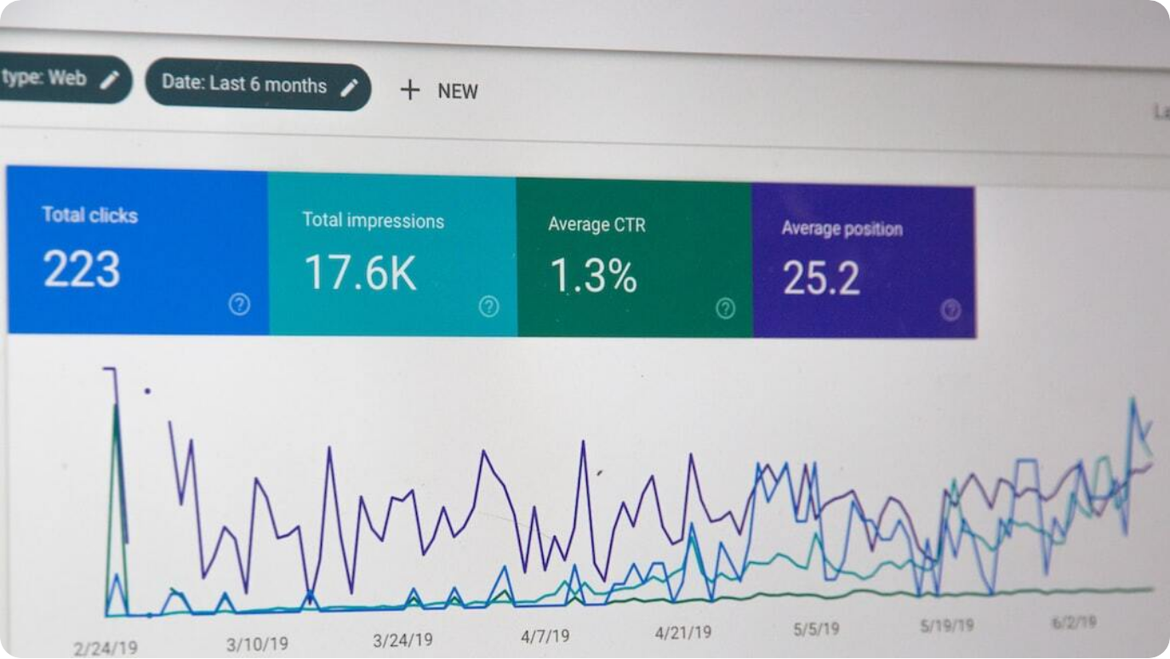
What is Data Analytics?
Definition, Objectives, and Real-World Relevance
Definition: Data Analytics is the process of examining datasets to uncover patterns and support decision-making using computational and statistical methods.
Core Objectives: Transform raw data into actionable insights, enable evidence-driven decisions, and optimize business processes.
Relevance Across Sectors: Used in e-commerce, finance, healthcare, and agriculture—ranging from fraud detection to crop yield prediction.
Photo by Stephen Phillips - Hostreviews.co.uk on Unsplash
Notes:
Let’s now define what we mean by data analytics and why it has become central to so many domains. At its core, data analytics is about using data-driven techniques—statistical, computational, and visual—to extract meaning and guide decisions.
Its primary objectives are threefold: to transform raw data into insights, to support decisions with evidence rather than intuition, and to optimize business or operational processes through measurable improvements.
The power of data analytics is evident across industries. In e-commerce, it drives personalized recommendations. In finance, it detects fraud. In agriculture, it forecasts yields. In healthcare, it supports clinical decision-making. These applications illustrate how critical analytics has become to innovation and operational success.

Slide 6

Importance of Data Analytics
Business Value and Societal Impact
Business Efficiency: Enables streamlined operations, informed decisions, and increased productivity through data-driven insights.
Innovation Driver: Powers product and service innovation by identifying market needs and performance gaps.
Societal Benefits: Improves public health, urban planning, and environmental forecasting, enhancing quality of life.
Proven ROI: Case in point: Netflix saves over $1B annually via analytics-driven personalization.
Photo by Adeolu Eletu on Unsplash
Notes:
Data analytics is much more than a tool for business—it’s a foundational capability that enhances efficiency, innovation, and even social wellbeing. For organizations, leveraging analytics translates to higher productivity, better risk management, and stronger strategic alignment.
From a societal standpoint, analytics contributes to smarter cities, proactive healthcare planning, and climate modeling. These improvements can elevate both public services and everyday life.
One powerful example is Netflix. By using analytics to personalize content recommendations, it saves over $1 billion annually by reducing customer churn. This underscores how even modest performance improvements, scaled across millions, can yield enormous value.

Slide 7

Example: Netflix Customer Churn Reduction
How Personalization Yields Massive Cost Savings
Analytics Pipeline: Tracks user behavior → applies ML models → recommends personalized content to reduce churn.
Business Logic: Customer acquisition is expensive—retention via personalization is far more cost-effective.
Quantified Impact: Even a 4% churn reduction among 250M users at $10/month yields ~$1.2B in savings annually.
Photo by Samet Özer on Unsplash
Notes:
Netflix offers a powerful case study in how data analytics translates directly into financial savings. The company tracks vast quantities of user behavior data—from watch times to content ratings—and uses machine learning to make highly personalized recommendations.
This personalization keeps users engaged. If subscribers can easily find shows they enjoy, they’re less likely to cancel. Given that acquiring a new customer is more expensive than retaining an existing one, minimizing churn is vital for profitability.
In fact, analytics-enabled personalization helps Netflix save over a billion dollars per year. A simple churn reduction of just 4% across 250 million users, each paying around $10/month, translates into $1.2 billion in retained revenue—demonstrating analytics’ transformative power.

Slide 8



Example: Precision Farming with Analytics
Agritech Applications for Yield Optimization
Data Collection
IoT sensors and drones gather soil moisture, weather, NDVI, and fertilizer data in real time.
Analytics Pipeline
ML models predict irrigation needs, pest risks, and expected yield, guiding timely interventions.
Measured Outcomes
30% reduction in water use, 20% less fertilizer, and 10–15% higher yield—translating to global savings.
Notes:
Precision farming showcases how analytics transforms traditional agriculture into a highly optimized and efficient practice. Using data from IoT sensors, drones, and satellite imagery, agritech companies monitor variables like soil moisture, plant health, and weather in real time.
Analytics and machine learning then process this data to deliver actionable insights—such as when and where to water or apply fertilizer. These decisions are no longer guesswork; they're guided by predictive models trained on thousands of data points.
The results speak for themselves: better yields, lower input costs, and more sustainable farming. Precision agriculture isn’t just an innovation—it’s a global necessity, helping feed a growing population while conserving resources.

Slide 9

Example: Data Analytics in Drug Discovery
Transforming Pharma R&D with AI and Big Data
R&D Bottlenecks: Traditional drug development takes 10–15 years and costs $1–2B with a low success rate.
Data Sources: Uses genomic data, compound libraries, protein structures, and clinical trial outcomes.
Role of Analytics: AI predicts target-binding molecules, accelerates virtual screening, and discovers repurposable drugs.
Photo by Volodymyr Hryshchenko on Unsplash
Notes:
Drug discovery has long been a time-consuming and costly endeavor, often taking over a decade and billions in investment for each successful treatment. The odds are slim—only 1 in 5,000 compounds reaches the market.
Enter data analytics and AI. By tapping into vast datasets—like genomic sequences, chemical structures, protein maps, and trial outcomes—pharma researchers can now identify promising drug candidates far earlier and more accurately.
From virtual screening that eliminates millions of compounds digitally, to drug repurposing that revives shelved compounds for new uses, analytics reshapes the entire R&D pipeline. The result? Faster development, reduced costs, and a higher success rate in bringing life-saving treatments to market.

Slide 10

Drug Discovery with Analytics
Predictive Modeling, Repurposing & Impact
AI Integration: Predictive models forecast binding potential; virtual screening reduces lab testing by 90%.
Drug Repurposing: Analytics finds new therapeutic uses for existing compounds, bypassing early-stage R&D.
Clinical & Financial Benefits: AI cuts trial failures by 20–30% and may save $70–100B annually in global pharma R&D.
Photo by Hush Naidoo Jade Photography on Unsplash
Notes:
Continuing the exploration of analytics in drug discovery, we now focus on the transformative power of predictive modeling and drug repurposing.
AI-based predictive models help scientists identify molecules most likely to bind to a given disease target. Instead of testing millions of compounds in the lab, virtual screening algorithms narrow down the best candidates—saving over 90% of the time and cost.
Repurposing existing drugs—such as identifying arthritis treatments for viral infections—also accelerates progress. Since these compounds have known safety profiles, much of the early-stage testing can be skipped.
The impact is immense. Clinical trials become more efficient, patient matching more accurate, and global savings substantial. Estimates suggest that these innovations could reduce R&D costs by up to $100 billion each year.

Slide 11
Types of Data Analytics
Descriptive, Diagnostic, Predictive, Prescriptive, Visual
Descriptive: Summarizes past data trends to answer 'what happened?' using tools like SQL, Excel, BI dashboards.
Diagnostic: Investigates 'why did it happen?' via correlation, drill-downs, and statistical analysis.
Predictive: Uses ML and regression to answer 'what will happen?'—enabling proactive strategy.
Prescriptive: Recommends optimal actions based on simulations and optimization techniques.
Visual: Presents insights via dashboards and maps, enhancing comprehension and engagement.
Notes:
Data analytics can be categorized into five core types, each answering a different business question and building on the previous stage.
Descriptive analytics explains what happened by summarizing historical data. Diagnostic analytics goes deeper to explore the reasons behind those events. Predictive analytics forecasts what might occur using models trained on existing trends.
Prescriptive analytics recommends what actions to take, incorporating simulations and optimizations. Finally, visual analytics helps convey complex insights using intuitive graphical representations—crucial for decision-makers.
Together, these types create a full-spectrum analytics approach applicable across industries.

Slide 12
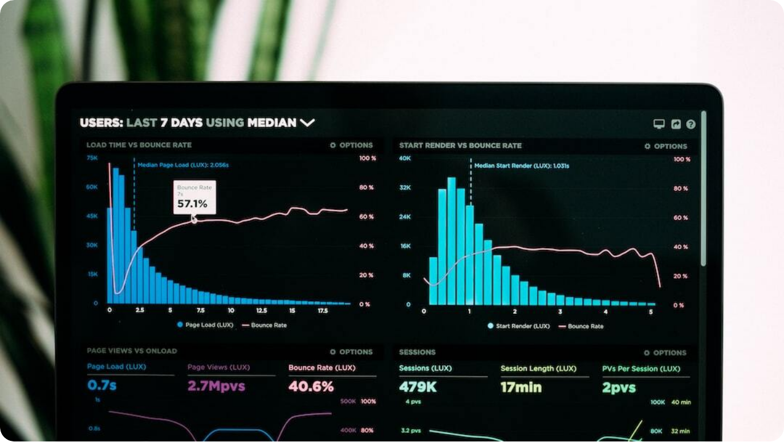
Descriptive Analytics
Understanding What Happened
Focus Area: Provides summaries of historical data to identify trends and patterns.
Real-World Examples: Netflix tracks viewership hours; agriculture measures past crop yields by region.
Tools & Techniques: SQL, Excel, BI dashboards like Tableau and Power BI are standard tools.
Output Value: Generates reports, charts, and dashboards that form the basis for further analysis.
Photo by Luke Chesser on Unsplash
Notes:
Descriptive analytics is the first layer of data analysis and answers the foundational question: 'What happened?' It converts raw data into meaningful summaries, helping organizations grasp performance trends and operational outcomes.
In media streaming, platforms like Netflix track total viewership for various shows—data that informs content strategy. In agriculture, summaries of past yields across geographies help understand regional productivity.
The tools for descriptive analytics include common spreadsheet platforms, SQL queries, and visual BI dashboards. While this form of analysis doesn’t provide explanations or forecasts, it forms the bedrock for deeper diagnostic or predictive insights.

Slide 13

Diagnostic Analytics
Explaining Why It Happened
Analytical Focus: Goes beyond 'what' to uncover reasons behind observed trends and outcomes.
Application Examples: Netflix investigates viewer drop-off; agriculture identifies yield dips due to weather or pests.
Techniques Used: Correlation analysis, drill-down BI tools, statistical tests using Python or R.
Strategic Relevance: Empowers proactive decision-making by isolating root causes of performance changes.
Photo by Agence Olloweb on Unsplash
Notes:
While descriptive analytics tells us what happened, diagnostic analytics digs deeper to explain why it happened. This level of analysis is crucial for addressing performance issues and improving decision-making based on causation rather than assumption.
For example, Netflix might use diagnostic analytics to understand why users dropped off after the third episode of a series—perhaps due to poor pacing or reviews. In agriculture, if crop yields decline, diagnostics might reveal causes like insufficient rainfall or pest outbreaks.
Tools range from drill-down dashboards to statistical packages in Python or R. The goal is clarity—turning observations into insight by identifying the root causes of variation in outcomes.

Slide 14
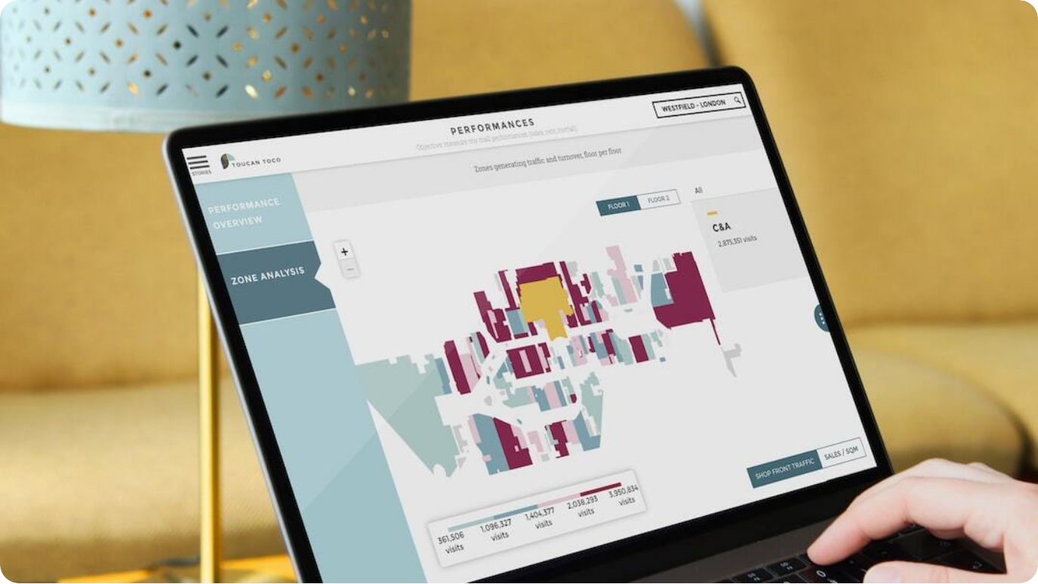
Predictive Analytics
Forecasting What Will Happen
Core Function: Uses historical data with ML and statistical models to forecast future outcomes.
Use Cases: Netflix predicts viewer preferences; agriculture forecasts yield using soil, weather, and imagery.
Tech Stack: Includes regression models, time series analysis, ML frameworks like Scikit-learn and TensorFlow.
Decision Value: Enables proactive planning and risk mitigation through accurate forecasting.
Photo by Adrien WIESENBACH on Unsplash
Notes:
Predictive analytics allows organizations to look forward rather than backward—using historical and current data to anticipate future events. It provides a powerful edge in planning, inventory management, customer retention, and risk forecasting.
In media, platforms like Netflix leverage predictive models to suggest what users are likely to watch next, keeping them engaged. In agriculture, predictions about rainfall or soil productivity help farmers make informed planting decisions.
Machine learning frameworks and statistical techniques are at the heart of this stage. These models learn patterns from existing data and apply them to forecast future values—transforming uncertainty into a manageable factor.

Slide 15
Prescriptive Analytics
Determining What Should Be Done
Purpose: Recommends actions based on data-driven models using optimization and simulation.
Real Applications: Netflix prescribes thumbnails or trailers to boost engagement; agriculture suggests specific irrigation plans.
Techniques: Uses reinforcement learning, decision trees, and optimization algorithms.
Actionable Outcomes: Directly informs decision-making to maximize results and minimize risk.
Photo by Luke Chesser on Unsplash
Notes:
Prescriptive analytics is the most advanced form of analytics, answering the key question: 'What should we do?' It uses insights from previous analytics layers to recommend specific actions through simulation and optimization models.
A prime example is Netflix, which doesn’t just predict what you might watch—it prescribes the best thumbnail or trailer for each user to improve click-through and retention. In agriculture, such systems can recommend irrigation or fertilizer plans tailored to weather, crop type, and soil condition.
The methods include reinforcement learning, optimization modeling, and scenario simulation. The goal isn’t just insight—it’s action. This level of analytics provides a clear path forward, ensuring maximum efficiency and strategic value.

Slide 16




Visual Analytics
Clear Communication of Insights
Purpose
Transforms complex data into intuitive visuals like charts, maps, and dashboards.
Real-Time Utility
Used in platforms like Netflix and GIS dashboards to monitor and act on data quickly.
Tools Used
Includes Tableau, Power BI, QGIS, and Python libraries such as Matplotlib and Plotly.
Strategic Value
Accelerates comprehension and supports executive-level decision-making.
Notes:
Visual analytics bridges the gap between raw data and human understanding. By turning data into visuals, it allows even non-technical stakeholders to identify trends, anomalies, and opportunities at a glance.
Netflix, for example, uses heatmaps and dashboards to monitor viewing patterns by geography, time, and device type. In agriculture, GIS-based visual dashboards help farmers track rainfall, pest outbreaks, and crop health across vast areas.
These visuals are powered by tools like Tableau, Power BI, and geospatial platforms like QGIS. Their ability to present data in a fast and intuitive way makes visual analytics indispensable for modern decision-making.

Slide 17

What is the Data Analytics Lifecycle?
A Structured Approach to Extracting Insights
CRISP-DM Foundation: Lifecycle model based on the Cross-Industry Standard Process for Data Mining developed by IBM.
Phased Process: Includes stages such as defining objectives, cleaning data, modeling, and stakeholder communication.
Strategic Relevance: Supports iterative learning, reproducibility, and better decision outcomes.
Business Value: Guides analytics teams from problem formulation to actionable results.
Photo by The CEO Kid on Unsplash
Notes:
The data analytics lifecycle offers a structured framework for transforming raw data into meaningful business insights. Most widely used is the CRISP-DM model—an open-standard process originally developed by IBM.
The lifecycle comprises key phases including business understanding, data preparation, modeling, evaluation, and deployment. It promotes methodological rigor while allowing room for iterative refinement as insights emerge.
Organizations benefit by ensuring consistency and alignment with business objectives. This framework not only supports project clarity but also facilitates collaboration between data professionals and decision-makers.

Slide 18




Why the Analytics Lifecycle Matters
Ensuring Quality, Efficiency, and Strategic Value
Structured Workflow
Facilitates a systematic approach from data acquisition to insight delivery.
Data Quality Assurance
Emphasizes cleaning and preprocessing, ensuring reliable outputs.
Business Alignment
Connects data activities to strategic goals, making insights relevant and actionable.
Sustainable Success
Supports monitoring, feedback loops, and continual improvement.
Notes:
Following a defined analytics lifecycle ensures clarity, accuracy, and strategic alignment across data projects. It reduces chaos and improves reproducibility by offering a phased approach.
Emphasizing steps like data cleaning and preprocessing improves data quality—an essential factor for credible insights. Meanwhile, keeping the process anchored to business goals ensures that the results are both relevant and actionable.
By supporting feedback loops and ongoing monitoring, this lifecycle model enables organizations to not only reach conclusions, but also evolve their strategies based on data-driven learning.

Slide 19
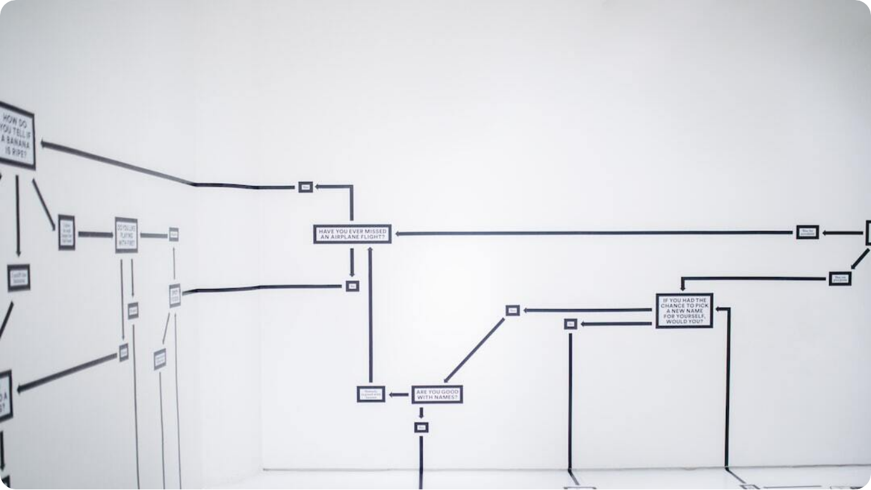
Lifecycle of Data Analytics
CRISP-DM Phases at a Glance
Problem Understanding: Begins with identifying business objectives and data needs.
Data Preparation: Cleansing, transforming, and structuring data for analysis.
Modeling & Deployment: Applies statistical or ML models, evaluates, and implements solutions.
Iteration & Communication: Cycles through evaluation and communicates results to stakeholders.
Photo by Hanna Morris on Unsplash
Notes:
This visual overview of the CRISP-DM analytics lifecycle captures the iterative and flexible nature of data projects. The process begins with defining the problem and identifying data requirements. From there, it progresses to preparation—ensuring the dataset is suitable for analysis.
Modeling involves selecting and applying the right analytical techniques, while evaluation ensures that results align with objectives. Deployment brings the insights into real-world application, often with tools or dashboards.
Throughout the process, communication with stakeholders is vital to refine the approach and ensure relevance. The loop repeats as new insights lead to new questions.

Slide 20



Phase 1: Define the Objective
Clarifying Analytical Goals
Strategic Start
Begins with explicitly stating the purpose of the analysis.
Contextual Relevance
Goals vary by domain—e.g., reduce churn in streaming or optimize fertilizer in farming.
Requirement Gathering
Utilizes business discussions and domain knowledge to guide scope.
Alignment
Ensures all stakeholders agree on what success looks like.
Notes:
The first step in the analytics lifecycle is to define the objective. Without a clear and focused goal, data analysis efforts may be misdirected, leading to wasted resources and vague conclusions.
This phase involves collaborating with stakeholders to understand the business challenge and desired outcomes. For instance, Netflix may aim to reduce churn, while an agricultural firm might want to improve crop predictions.
Clear objectives shape all subsequent phases—from data collection to modeling. This alignment ensures that results are meaningful and directly tied to strategic goals.

Slide 21

Phase 2: Understanding the Data
Explore What You’re Working With
Initial Exploration: Understand the structure, columns, data types, and null values.
Domain Validation: Assess if the available data is suitable for the stated goal.
Example Contexts: Netflix checks watch time data; farming projects validate weather and soil features.
Tools Used: Python (Pandas Profiling), SQL, Excel, and visualization libraries.
Photo by Amanda Jones on Unsplash
Notes:
After setting a clear objective, the next step is understanding the data itself. This involves assessing the dataset’s structure, identifying variables, and verifying if the data aligns with the defined goal.
For instance, if the goal is to predict Netflix user churn, you’d look into attributes like watch history, device type, and session length. In agriculture, you’d explore variables like rainfall, crop type, and historical yield.
Exploratory Data Analysis (EDA) is essential here. It reveals missing values, outliers, and relationships between features, guiding the necessary cleaning and transformation steps that follow.

Slide 22


Phase 3: Data Cleaning & Transformation
Preparing Data for Analysis
Cleaning Steps
Handle duplicates, fill missing values, and remove inconsistencies.
Transformation
Create derived metrics or restructure data for modeling efficiency.
Real-World Use
Netflix calculates average watch time; farms classify seasonal variables.
Tech Stack
Uses Pandas, NumPy, SQL, and ETL tools like Talend or Informatica.
Notes:
Once the data has been understood, the next step is to clean and transform it. Data rarely comes in perfect shape—it’s often messy, incomplete, or inconsistent.
Cleaning may involve removing duplicates, correcting errors, or filling in missing values. Transformation can include deriving new metrics, restructuring formats, or categorizing features for better analysis.
In practice, Netflix might create user-level averages from raw logs, while agritech firms might segment rainfall by season. These steps ensure the data is usable, reliable, and aligned with the objectives.

Slide 23

Phase 4: Data Enhancement
Adding Value from External Sources
Purpose: Boosts analytical richness by merging third-party or non-traditional datasets.
Examples: Netflix adds IMDB ratings or social trends; agriculture uses weather APIs or satellite imagery.
Tools: Web scraping, API integration, data aggregation platforms.
Benefit: Refines models and improves prediction accuracy by broadening data scope.
Photo by Markus Spiske on Unsplash
Notes:
Data enhancement is the phase where we enrich internal datasets with external sources to add depth and context. These could be structured APIs, unstructured web data, or institutional records.
For example, Netflix may enhance user engagement data with public ratings or trends from social media. In agriculture, integrating satellite imagery or forecast data from meteorological services enables more precise modeling.
The integration process often uses APIs or scraping tools and helps improve model performance while capturing more real-world complexity.

Slide 24
Phase 5: Data Analytics & Modeling
Turning Data Into Insights
Analytical Process: Apply models to uncover patterns and generate forecasts.
Model Types: Regression, clustering, decision trees, and collaborative filtering.
Case Usage: Netflix recommends shows based on viewing clusters; farms forecast yields.
Tools Used: Python (Scikit-learn, TensorFlow), R, statistical software.
Photo by Adrien WIESENBACH on Unsplash
Notes:
In this phase, we apply analytical and machine learning models to extract insights from the prepared dataset. This is where the real intelligence of data analytics starts to shine.
Model types vary based on the problem—Netflix may use collaborative filtering for recommendations, while agritech firms may apply regression to predict yields or clustering to segment soil zones.
The choice of model and toolset (Python, R, or commercial solutions) depends on the nature of the data and the desired outcome. The end goal remains: turn data into action.

Slide 25

Quality and Quantity of Data
Cornerstones of Reliable Analytics
Critical Role: High-quality data ensures valid, actionable results; poor data leads to misleading insights.
DQAF Framework: Assesses correctness, timeliness, relevance, and standard adherence with scores from 0–100.
Management Practices: Data profiling, validation, cleansing, and monitoring enhance data integrity.
Decision Impact: Business processes and analytics outcomes directly rely on data quality standards.
Photo by engin akyurt on Unsplash
Notes:
Data quality is the foundation upon which all analytics efforts are built. Without clean, accurate, and timely data, even the most advanced models yield unreliable outputs.
The Data Quality Assessment Framework (DQAF) provides a standardized method to assess data across dimensions such as completeness, accuracy, and timeliness. Scores help track and improve data over time.
Organizations that implement regular profiling, validation rules, and monitoring systems protect themselves from costly decisions based on faulty data. Analytics is only as good as the information it’s built on.

Slide 26

Data Quality Dimensions
Understanding What Makes Data Reliable
Completeness: Measures missing values; essential for comprehensive analytics.
Timeliness: Data should be up-to-date and contextually relevant.
Validity: Ensures adherence to data formats, policies, or system requirements.
Integrity & Uniqueness: Guarantees trustworthy values and prevents duplication.
Photo by Siora Photography on Unsplash
Notes:
Several dimensions contribute to defining data quality—each addressing a unique aspect that impacts usability.
Completeness relates to missing data, which can bias results. Timeliness ensures data is current and reflects the present state. Validity checks if the values entered conform to predefined rules—like correct date formats or dropdown selections.
Data integrity confirms accuracy, while uniqueness ensures no redundant records. Together, these dimensions build the trust necessary for high-stakes decision-making in analytics.

Slide 27


Essential Aspects of Good Data Quality
Accuracy, Relevance, and More
Accuracy
Error-free values enable reliable analysis and decisions.
Completeness
Captures all required information for a given task or analysis.
Relevance
Data must align with current analytical goals and objectives.
Consolidation
Avoids duplication to ensure unique and clean datasets.
Notes:
Beyond dimensions, good data quality rests on key principles that ensure its value in analytics. Accuracy is foundational—without it, even the best models will mislead. Completeness ensures no critical data is missing, avoiding biased results.
Relevance is equally important—data must be contextually appropriate to the decision at hand. Using outdated or unrelated information can steer conclusions astray. Consolidation ensures a dataset holds only unique entries, preventing duplication and redundancy.
Together, these principles strengthen trust in data-driven processes and outputs.

Slide 28
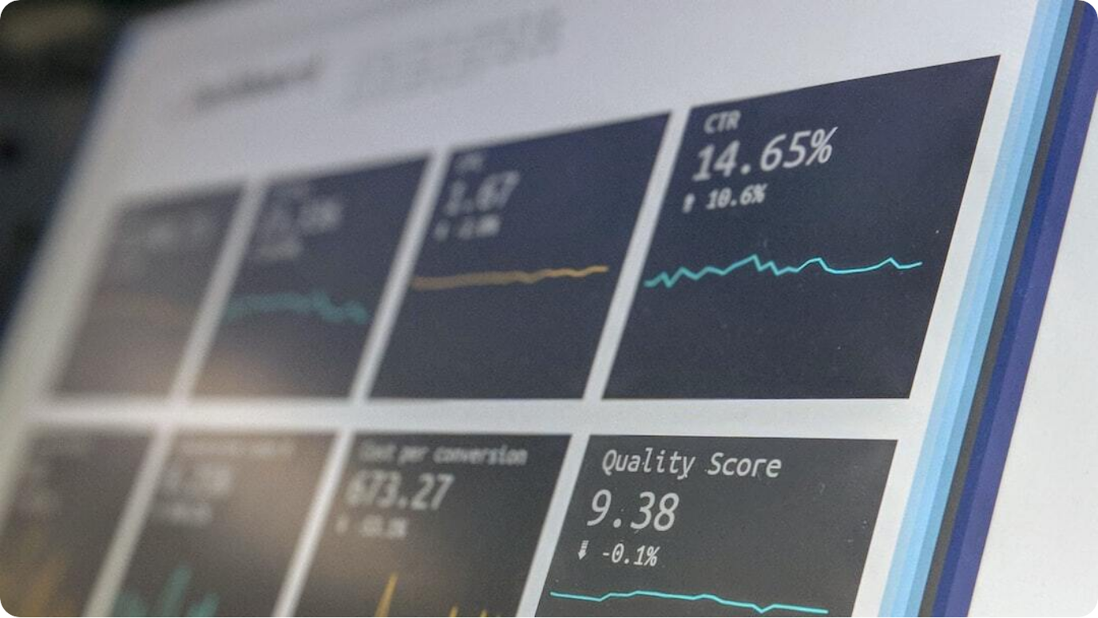
How to Improve Data Quality
From Standards to Monitoring
Set Quality Standards: Define criteria for completeness, accuracy, and consistency upfront.
Validation & Profiling: Use automated checks to catch anomalies during data entry.
Governance Framework: Implement roles and responsibilities for data stewardship.
Ongoing Audits: Schedule regular data reviews and automated monitoring alerts.
Photo by Stephen Dawson on Unsplash
Notes:
Improving data quality is not a one-time task—it’s an ongoing process rooted in defined standards and institutional practices. Start by establishing clear definitions for what constitutes high-quality data in your context.
Validation rules and profiling help catch issues at the point of entry or ingestion. Data governance provides accountability by assigning stewards and defining policies.
Regular audits, supported by automated monitoring tools, keep quality on track. This process ensures that analytics remains grounded in trusted data, sustaining credibility and business value.

Slide 29



Types of Data Storage
Structured, Unstructured & Semi-Structured
Structured Data
Organized in tables with rows and columns; easily queried (e.g., SQL databases).
Unstructured Data
No predefined format; includes videos, images, PDFs, and audio files.
Semi-Structured
Has tags or markers (e.g., XML, JSON); flexible but partially organized.
Storage Formats
CSV, NoSQL, relational DBs, cloud lakes, and data warehouses.
Notes:
Data storage types vary based on structure and intended use. Structured data fits neatly into tables and is ideal for traditional SQL databases. It’s easy to store, query, and analyze.
Unstructured data—like video content, scanned documents, and freeform text—makes up the majority of enterprise data but requires advanced tools to analyze. Semi-structured data, such as JSON or XML files, strikes a balance by using metadata to retain some structure while remaining flexible.
These data types are stored using formats such as CSV, relational or NoSQL databases, or modern cloud-based data lakes and warehouses. The choice depends on analytics goals and scalability needs.

Slide 30

Data Storage Formats
Common File Types for Analytics
CSV & Excel: Used for small- to medium-scale structured data and spreadsheets.
JSON & XML: Ideal for hierarchical and semi-structured datasets; widely used in APIs.
Database Dumps: Exported full datasets from relational or NoSQL DBs for backup or migration.
Media Files: Unstructured formats like .mp4, .jpeg, and .mp3 often used in multimedia analytics.
Photo by apoorv mittal on Unsplash
Notes:
Analytics projects interact with various storage formats, each suited for different data types and workloads. CSV and Excel files are widely used for flat tables and lightweight analyses—they’re user-friendly and compatible across tools.
JSON and XML provide structure for nested data and are key in web APIs and logs. For example, a streaming service might log user activity in JSON.
Database dumps preserve relational integrity and are essential for full backups or bulk migrations. Media files—though unstructured—are critical in domains like healthcare (e.g., X-rays), entertainment, or surveillance analytics.
Choosing the right format enhances data accessibility, processing, and modeling.

